Slide 1
Snowflake Training

Slide 2
Agenda
Snowpipe
LAB
Search Optimization
LAB
Cloning
LAB
Data Sharing
LAB
Streams and Tasks
LAB
Snowpark
LAB
Day 4

Slide 3
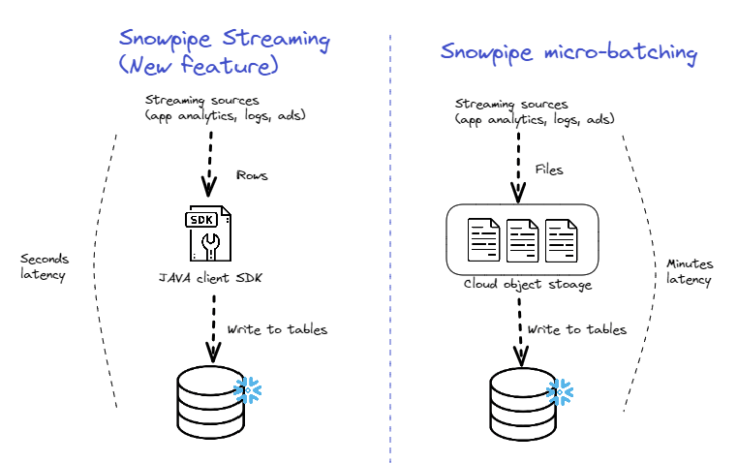
SNOWPIPE – BATCH & Streaming

Slide 4
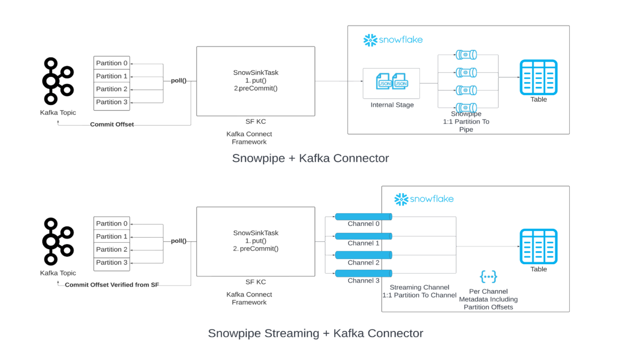
KAFKA – BATCH & STEAMING

Slide 5
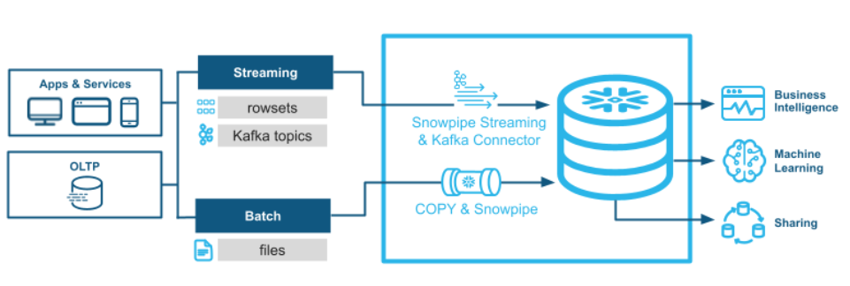
SNOWPIPE – BATCH & Streaming
Notes:
select get_ddl('table', 'mydb.public.salesorders’);
Temporary tables only exist within the session in which they were created and persist only for the remainder of the session.
This means you can create temporary and non-temporary tables with the same name within the same schema.
If the Time Travel retention period for a permanent table is set to 0, it will immediately enter the Fail-safe period when it is dropped.
Transient and temporary tables have no Fail-safe period.
Materialized views are automatically and transparently maintained by SnowflakeFor non-materialized views, the IS_SECURE column in the Information Schema and Account Usage views identifies whether a view is secure.
Snowflake does not allow standard DML (e.g. INSERT, UPDATE, DELETE) on materialized views. Snowflake does not allow users to truncate materialized views.

Slide 6
comparison
 | Snowpipe Batch | Snowpipe Streaming
Latency | High – ideal for bulk load | Low – faster insights
Ordering | Ordering preserved within files, not across files | Ordering persevered across for a channel, not across channels
Duplication | Done on as per file level | Offset tokens enable exactly-once ingestion
Semantics | Ease of Use - Fire and forget semantics | Highly pluggable – fine grained application control
Ingestion Mechanism | File based – files are interoperable | Rowset based – data is not file based

Slide 7
LAB
Notes:
Show the impact of cloning of a schema that has a pipe configured on a table
Show that a share cannot be cloned

Slide 8
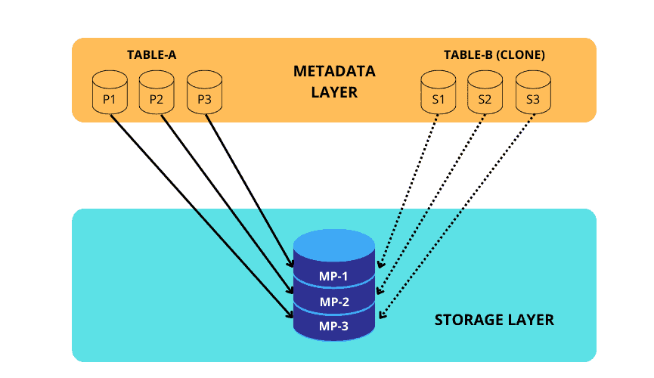
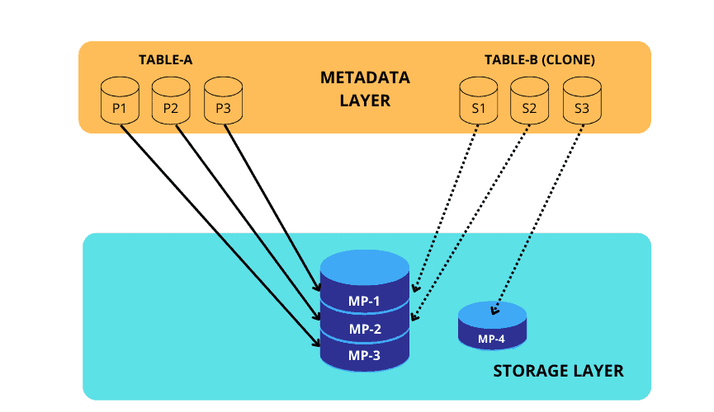
Cloning
“Fast Clone”, Saves times
Easy To Use
Reduced Storage Cost
Object can be cloned in its current state.
Object cab be cloned using time travel.

Slide 9
CLONING Consideration
If the source object is a database or schema, the clone inherits all granted privileges on the clones of all child objects contained in the source object.
CREATE <object> … CLONE statements for most objects do not copy grants on the source object to the object clone.
In a table, a column can reference a sequence that generates default values. When a table is cloned, the cloned table references the source or cloned sequence
By default, Automatic Clustering is suspended for the new table.
Internal (i.e., Snowflake) named stages cannot be cloned.
Cannot clone from a share.
Any pipes that reference an external stage are cloned.

Slide 10
LAB
Notes:
Show the impact of cloning of a schema that has a pipe configured on a table
Show that a share cannot be cloned

Slide 11
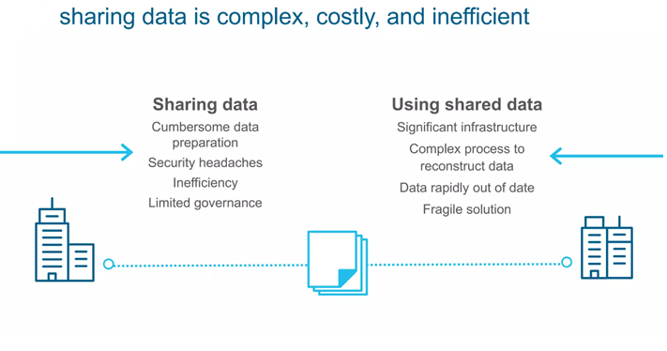
DATA SHARING

Slide 12
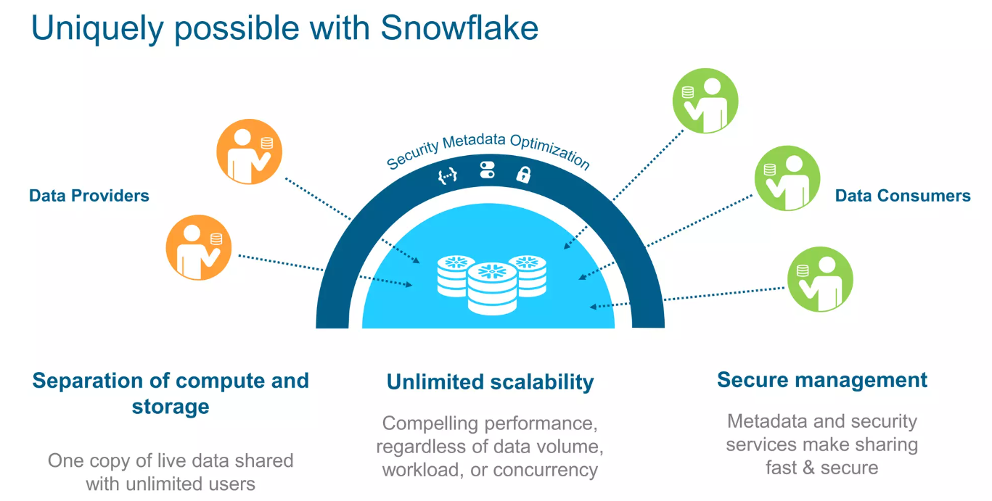
DATA SHARING

Slide 13
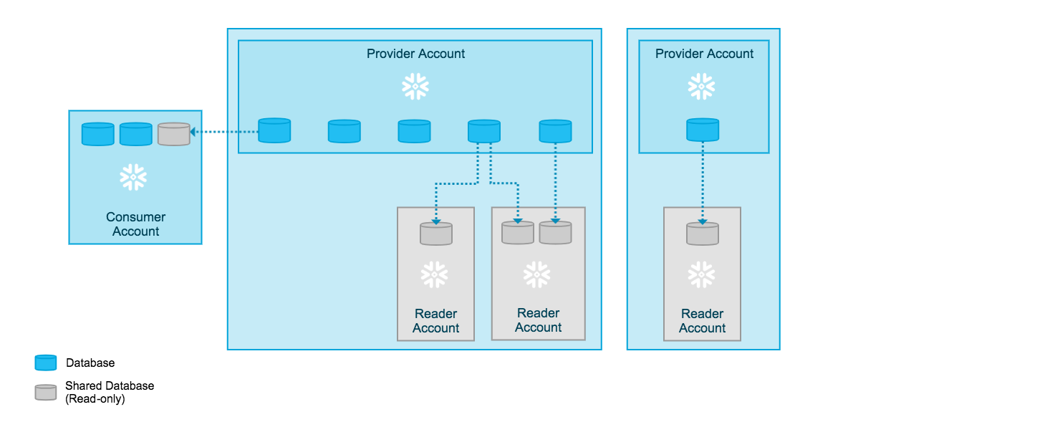
DATA SHARING

Slide 14
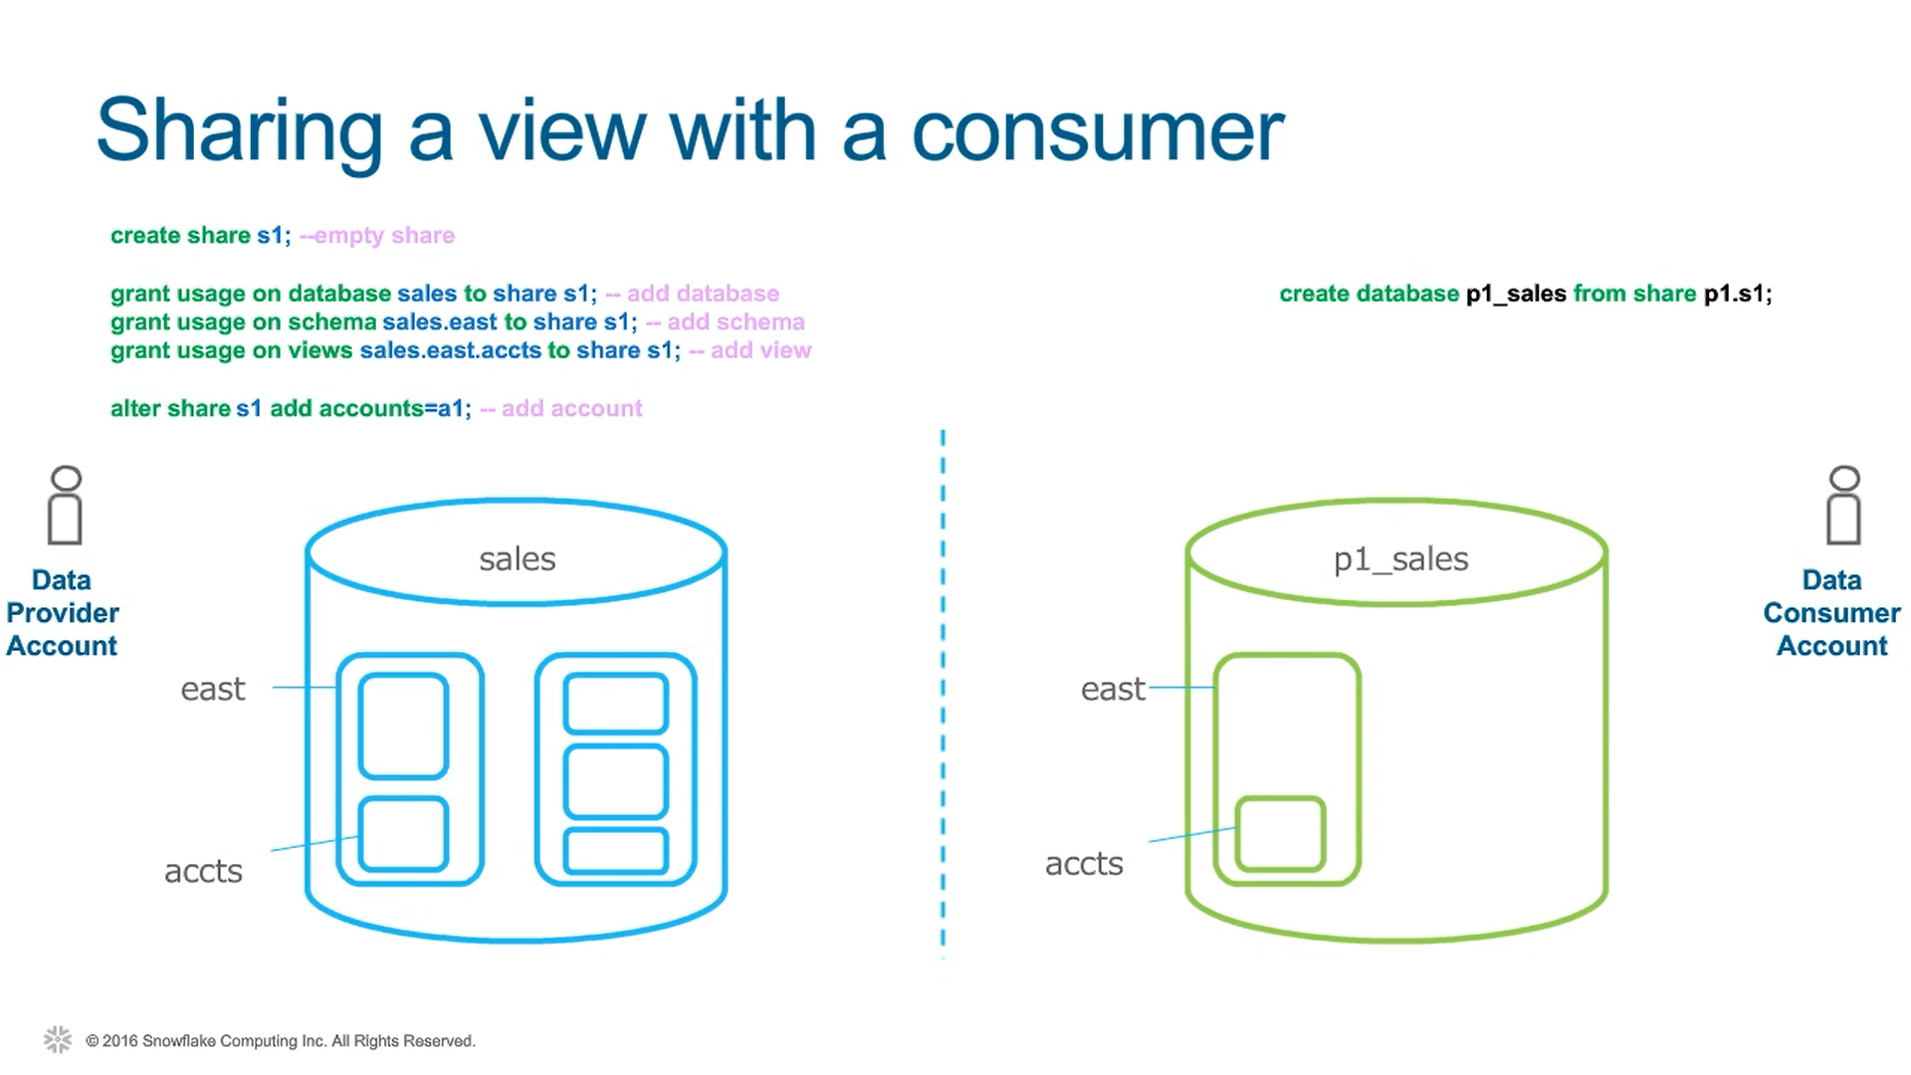
DATA SHARING
Notes:
select get_ddl('table', 'mydb.public.salesorders’);
Temporary tables only exist within the session in which they were created and persist only for the remainder of the session.
This means you can create temporary and non-temporary tables with the same name within the same schema.
If the Time Travel retention period for a permanent table is set to 0, it will immediately enter the Fail-safe period when it is dropped.
Transient and temporary tables have no Fail-safe period.
Materialized views are automatically and transparently maintained by SnowflakeFor non-materialized views, the IS_SECURE column in the Information Schema and Account Usage views identifies whether a view is secure.
Snowflake does not allow standard DML (e.g. INSERT, UPDATE, DELETE) on materialized views. Snowflake does not allow users to truncate materialized views.

Slide 15
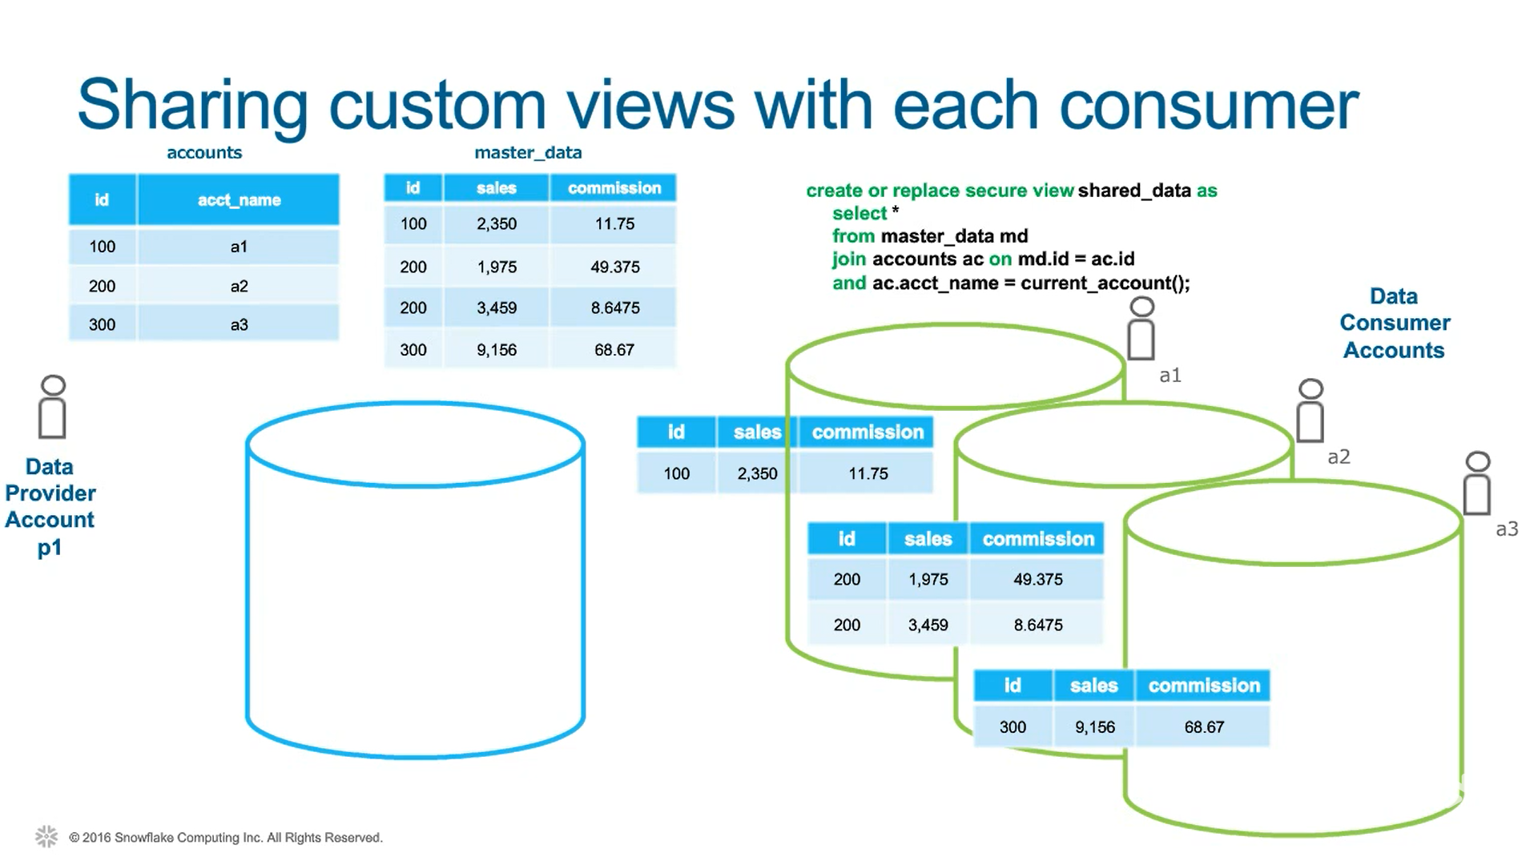
DATA SHARING
Notes:
select get_ddl('table', 'mydb.public.salesorders’);
Temporary tables only exist within the session in which they were created and persist only for the remainder of the session.
This means you can create temporary and non-temporary tables with the same name within the same schema.
If the Time Travel retention period for a permanent table is set to 0, it will immediately enter the Fail-safe period when it is dropped.
Transient and temporary tables have no Fail-safe period.
Materialized views are automatically and transparently maintained by SnowflakeFor non-materialized views, the IS_SECURE column in the Information Schema and Account Usage views identifies whether a view is secure.
Snowflake does not allow standard DML (e.g. INSERT, UPDATE, DELETE) on materialized views. Snowflake does not allow users to truncate materialized views.

Slide 16
LAB
Notes:
Show the impact of cloning of a schema that has a pipe configured on a table
Show that a share cannot be cloned

Slide 17
SNOWPARK
Snowpark provides an intuitive library for querying and processing data at scale in Snowflake
Snowpark libraries support is available for three languages: Java, Python, and Scala.
Support for authoring Snowpark code using local tools such as Jupyter, VS Code, or IntelliJ.
Support for pushdown for all operations, including Snowflake UDFs.
No requirement for a separate cluster outside of Snowflake for computations.
Notes:
select get_ddl('table', 'mydb.public.salesorders’);
Temporary tables only exist within the session in which they were created and persist only for the remainder of the session.
This means you can create temporary and non-temporary tables with the same name within the same schema.
If the Time Travel retention period for a permanent table is set to 0, it will immediately enter the Fail-safe period when it is dropped.
Transient and temporary tables have no Fail-safe period.
Materialized views are automatically and transparently maintained by SnowflakeFor non-materialized views, the IS_SECURE column in the Information Schema and Account Usage views identifies whether a view is secure.
Snowflake does not allow standard DML (e.g. INSERT, UPDATE, DELETE) on materialized views. Snowflake does not allow users to truncate materialized views.

Slide 18
LAB
Notes:
Show the impact of cloning of a schema that has a pipe configured on a table
Show that a share cannot be cloned

Slide 19
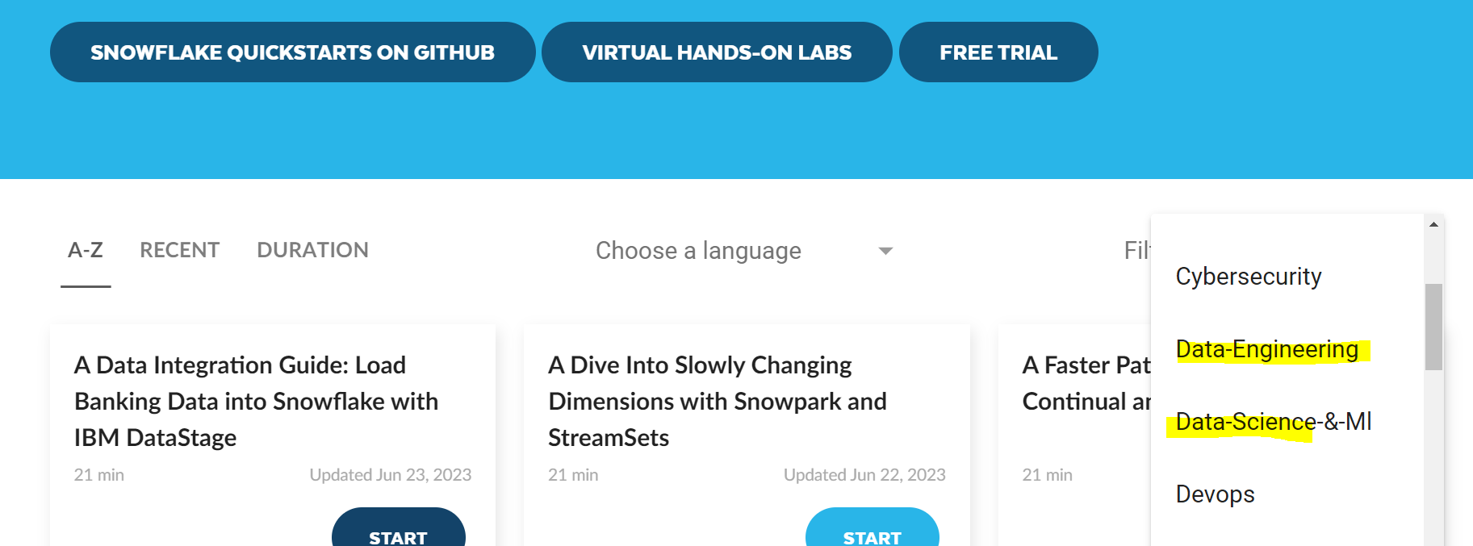
QuickStartS REF
https://quickstarts.snowflake.com/
Notes:
select get_ddl('table', 'mydb.public.salesorders’);
Temporary tables only exist within the session in which they were created and persist only for the remainder of the session.
This means you can create temporary and non-temporary tables with the same name within the same schema.
If the Time Travel retention period for a permanent table is set to 0, it will immediately enter the Fail-safe period when it is dropped.
Transient and temporary tables have no Fail-safe period.
Materialized views are automatically and transparently maintained by SnowflakeFor non-materialized views, the IS_SECURE column in the Information Schema and Account Usage views identifies whether a view is secure.
Snowflake does not allow standard DML (e.g. INSERT, UPDATE, DELETE) on materialized views. Snowflake does not allow users to truncate materialized views.

Slide 20
LAB
SNOWPARK
Notes:
Show the impact of cloning of a schema that has a pipe configured on a table
Show that a share cannot be cloned

Slide 21
Thank You

